Slide 1
Separation Methods
Ways to separate mixtures – Chapter 3: Matter & Its Properties

Slide 2
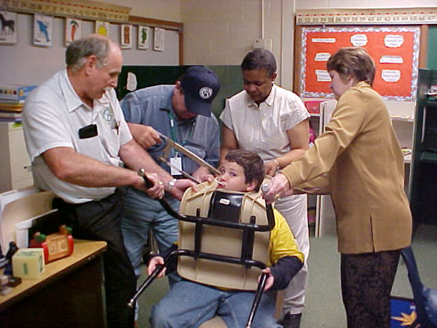
How do we separate …?

Slide 3
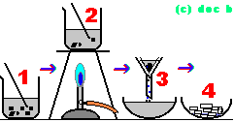
Separating Mixtures
Substances in a mixture are physically combined, so processes bases on differences in physical properties are used to separate component
Numerous techniques have been developed to separate mixtures to study components

Slide 4
Physical Means
Filtration
Chromatography
Centrifuging
Evaporating
Crystallization
Dissolving
Decantation
Sieving
Flotation

Slide 5
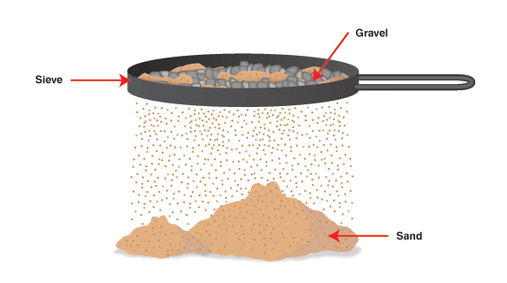
Sieving
a porous material is used to separate particles of different sizes.
method is most commonly used to effect gross separations, as of liquids from suspended crystals or other solids.
to accelerate filtration, pressure usually is applied.
a series of sieves is stacked, with the screen of largest hole size at the top

Slide 6
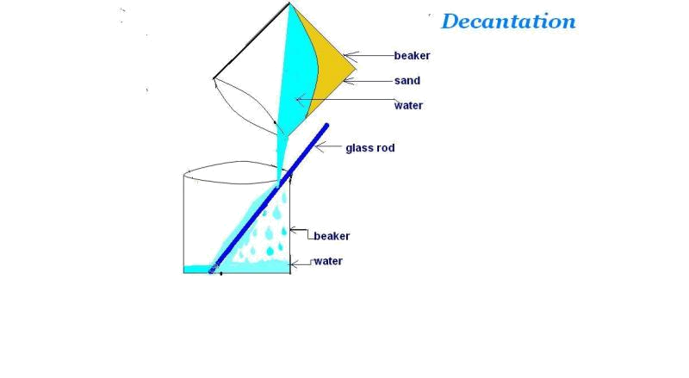

Decantation
Decanting is done to separate particulates from a liquid by allowing the solids to settle to the bottom of the mixture and pouring off the particle-free part of the liquid. Another method is to allow two immiscible liquids to separate and the lighter liquid is poured off.

Slide 7
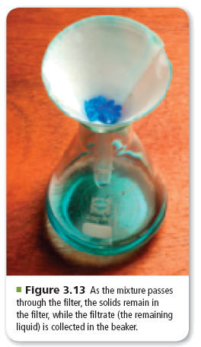
Filtration
Used to separate heterogeneous mixtures composed of solids and liquids
Uses a porous barrier to separate the solid from the liquid
Liquid passes through leaving the solid in the filter paper

Slide 8
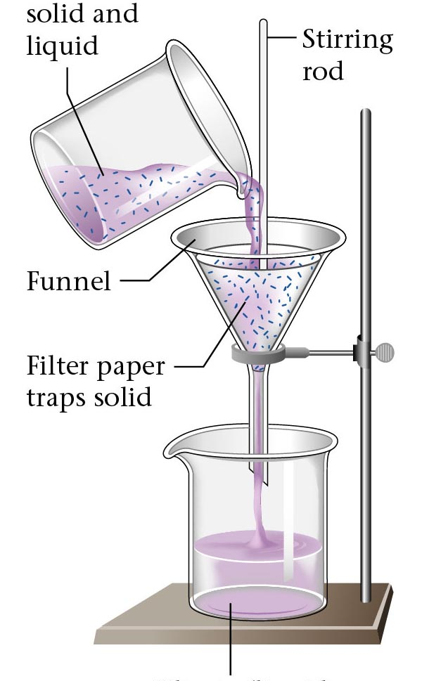
Mixture of
solid and
liquid
Stirring
rod
Funnel
Filtration can be used to separate an insoluble substance from a soluble substance
Filter paper
traps solid
Filtrate (liquid
component
of the mixture)
Notes:
Here you can introduce the terms Filtrate and residue.

Slide 9
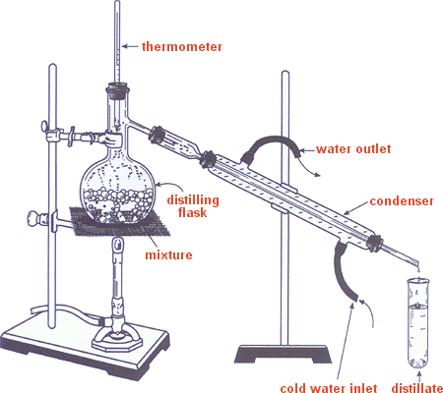
Distillation
Used to separate homogeneous mixtures
Based on differences in boiling points of substances involved

Slide 10
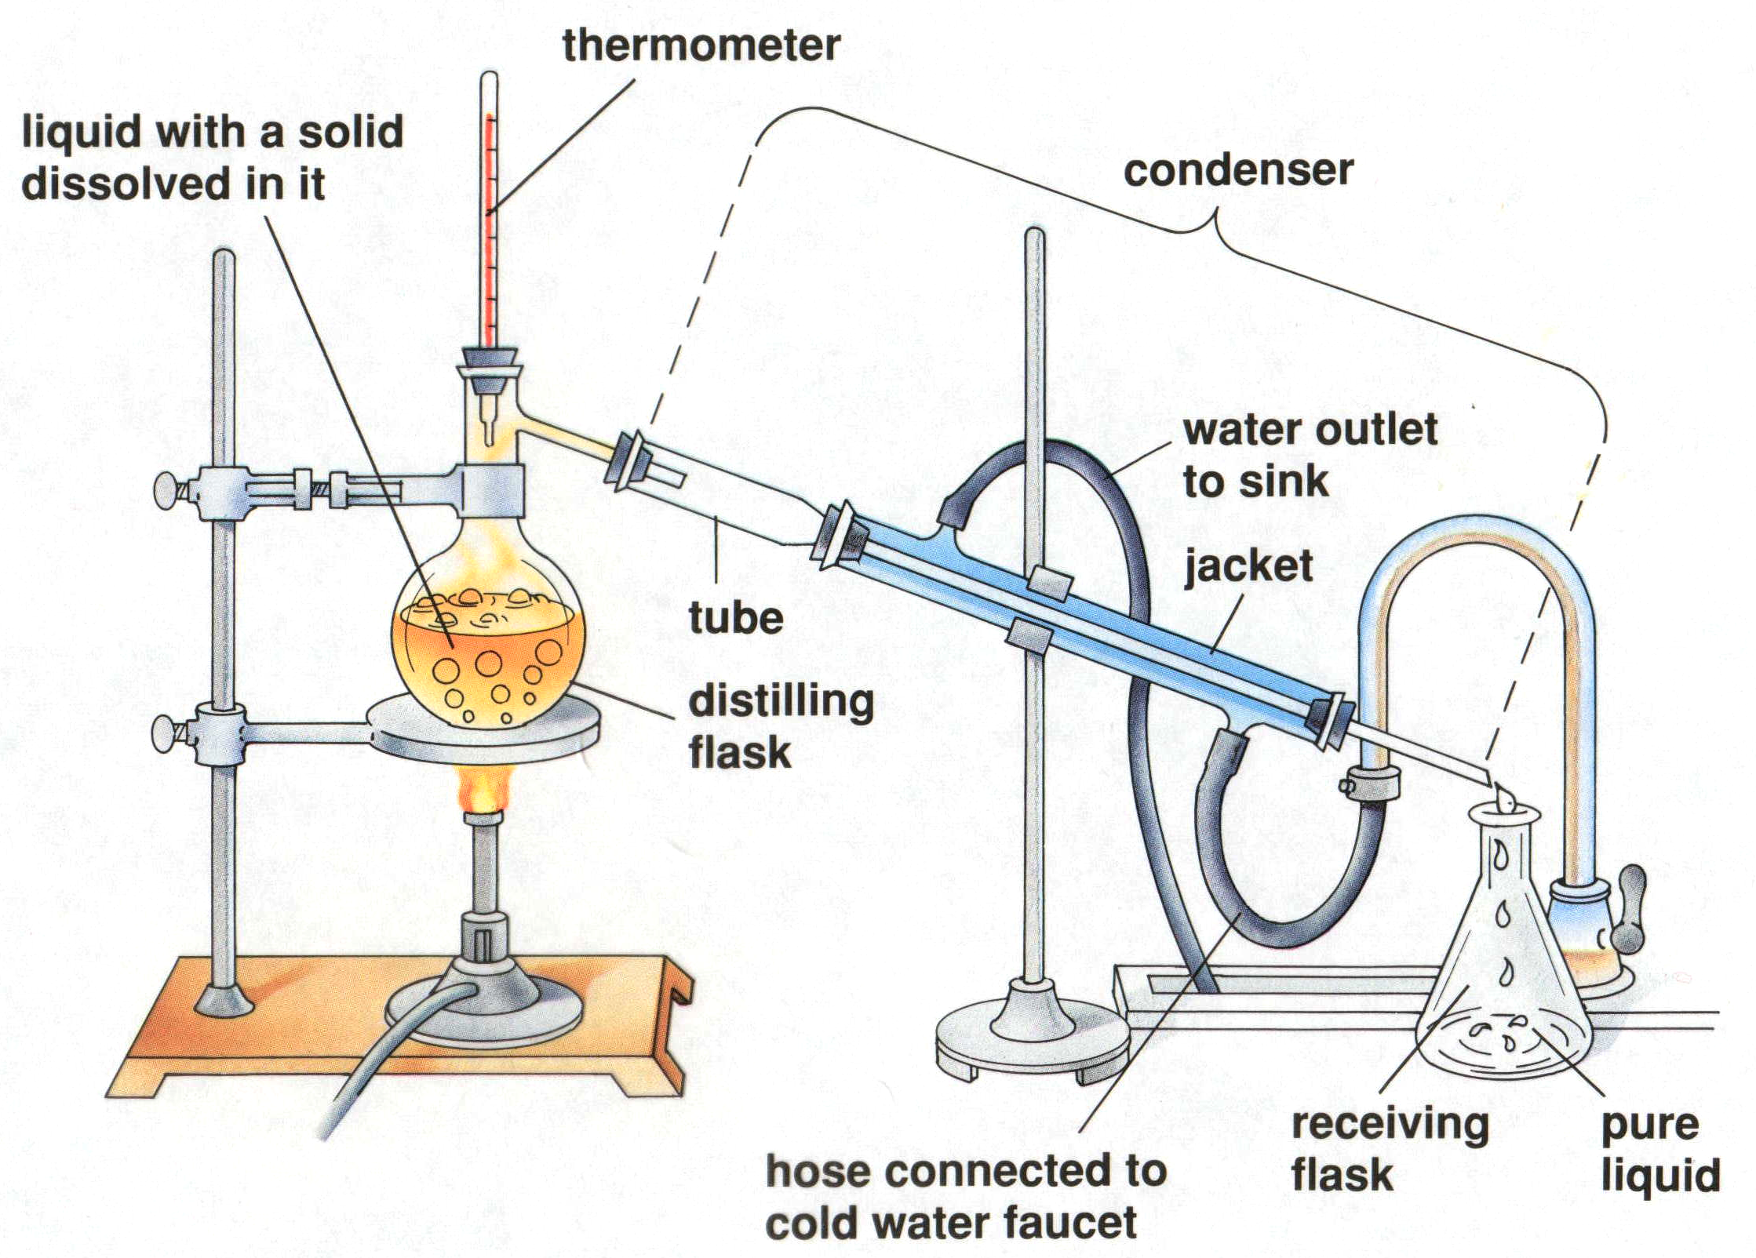
A Distillation Apparatus
thermometer
liquid with a solid
dissolved in it
condenser
tube
distilling
flask
receiving
flask
pure
liquid
hose connected to
cold water faucet
Dorin, Demmin, Gabel, Chemistry The Study of Matter , 3rd Edition, 1990, page 282
Notes:
“A Distillation Apparatus”
Description: This transparency shows an apparatus used for laboratory distillations.
Basic Concepts
The separation of substances by distillation occurs because the boiling point of the substances differ. The substance with the lowest boiling point boils away first.
Distillation is based on the principle that a substance will change from a liquid to a vapor during heating and from a vapor back to a liquid while cooling.
Teaching Strategies
Use this slide to explain to students how a distillation apparatus is used to purify liquids and to separate the components of liquid mixtures. Begin by reviewing the phases of matter, stressing the processes of evaporation and condensation. Remind students that different liquids have different boiling points. Point out that substances that are solids at room temperature usually have higher boiling points than do substances that are liquids at room temperature.
Questions
If the distilling flask shown in the diagram were open to the air (rather than being connected to the condensor), what would happen to each component of the mixture in the flask as boiling continued?
Explain your answer to question 1 in terms of the boiling points of the liquid and the dissolved solid.
In the distillation apparatus, the vaporized liquid must enter the condenser. The condenser consists of a long tube within another tube (the jacket). The substance in the central tube and the jacket cannot mix. Cold water enters at the bottom of the jacket and exits at the top.
What is the function of the condenser jacket?
How would changing the length of the condenser jacket affect how well it performs this function?
Explain why the liquid entering the receiving flask is pure.
To separate a mixture of methanol and water, you set up a distillation apparatus and heat the mixture to the boiling point of methanol, 65 oC.
What substance would you expect to collect at the receiving flask?
When you finish the experiment, you discover that the substance in the receiving flask is not pure. It still contains both water and methanol. Can you explain why? (Hint: Think about vapor pressures.)
Before automobiles were invented, crude petroleum was used mainly as a source of kerosene. The petroleum was heated in a device called a still. Gasoline, then considered to be useless, evaporated first into the air. Kerosene boiled off next and was condensed and collected. A tar-like residue remained in the still. From this information, what can you deduce about the boiling points of gasoline, kerosene, and the residue?
How will you know when all of one component has been separated?

Slide 11
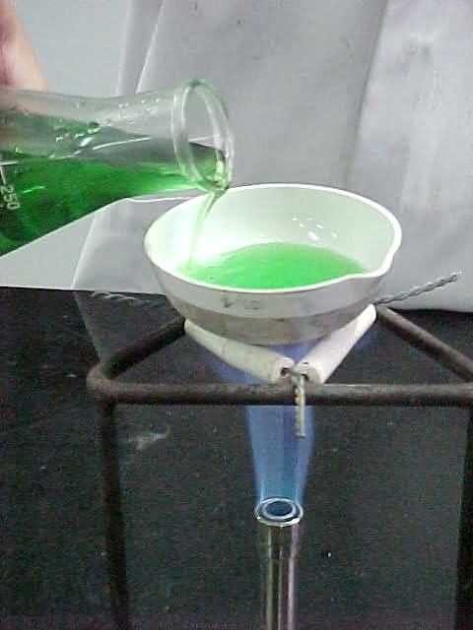
Evaporation can be used to separate a solute from the solvent in a solution
Notes:
Review the terms; solution, solute and solvent.

Slide 12
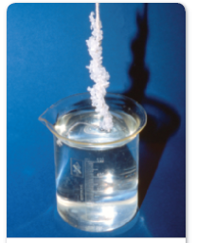
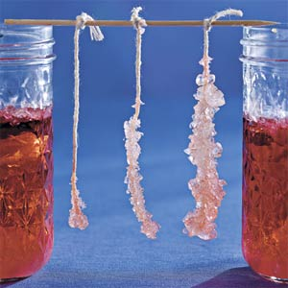
Crystallization
Separation technique that results in the formation of pure solid particles from a solution containing the dissolved substance
As one substance evaporates, the dissolved substance comes out of solution and collects as crystals
Produces highly pure solids
Rocky candy is an example of this

Slide 13
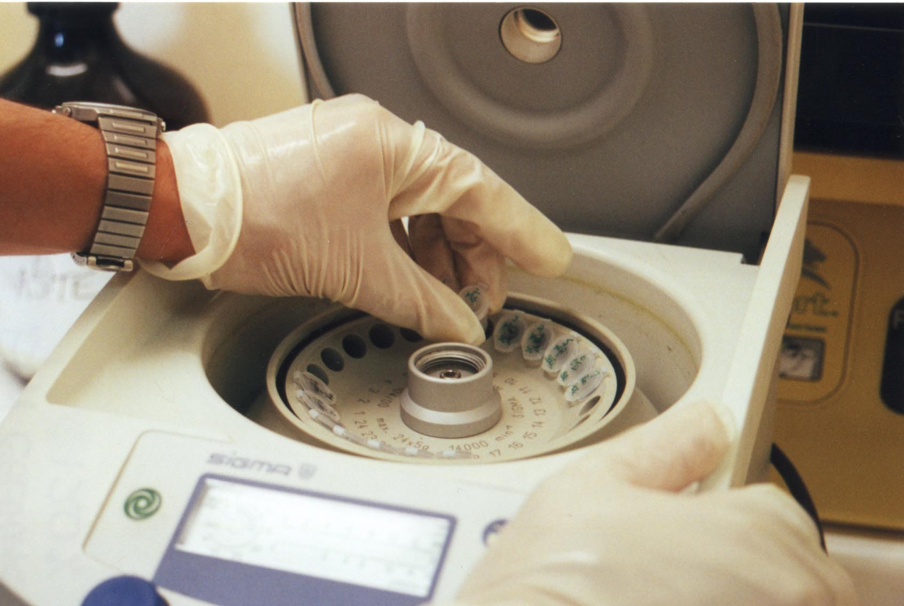
Centrifuging

Slide 14
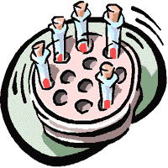
Centrifuges rotate containers of
liquids to separate suspended
materials with different densities.
Centrifuges separate different components of human blood or milk and to clarify solutions. A high speed separator can rotate at great speed to separate fat (cream) from milk.
The spin drier in washing machines is a type of centrifuge that throws out the liquid by the "centrifugal force" of the rotation.

Slide 15
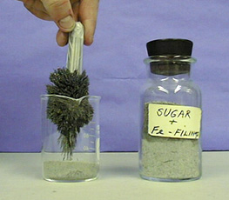
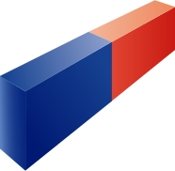
A magnet
Can be used to separate a magnetic substance from a non-magnetic substance
Notes:
Magnets are used in the re-cycling industry to separate ferrous and non ferrous metals.

Slide 16
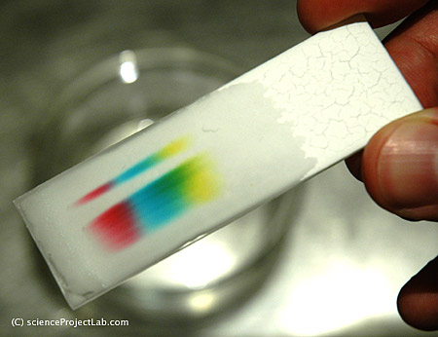
Chromatography
Separates components of a mixture based on ability of each component to be drawn across the surface of another material
Mixture is usually liquid and is usually drawn across chromatography paper
Separation occurs because various components travel at different rates
Components with strongest attraction for paper travel the slowest

Slide 17
Chromatography ( colour writing) is used to separate small amounts of chemicals so that they can be analysed.
Different substances or different components move at different speeds through a strip of wet paper, a gel or a gas.

Slide 18

Paper Chromatography
Notes:
http://www.moe.gov.sg/edumall/tl/digital_resources/chemistry/images/paper_chromatography.jpg

Slide 19
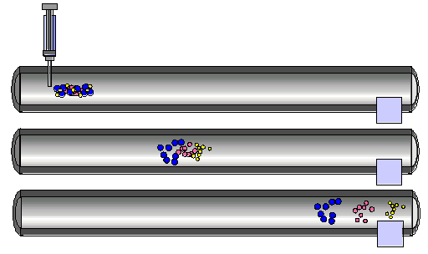
Separation by Chromatography
sample
mixture
a chromatographic column
stationary phase
selectively absorbs
components
mobile phase
sweeps sample
down column
detector
http://antoine.frostburg.edu/chem/senese/101/matter/slides/sld006.htm
Notes:
http://antoine.frostburg.edu/chem/senese/101/matter/slides/sld006.htm

Slide 20
Separation by Chromatography
sample
mixture
a chromatographic column
stationary phase
selectively absorbs
components
mobile phase
sweeps sample
down column
detector
http://antoine.frostburg.edu/chem/senese/101/matter/slides/sld006.htm
Notes:
http://antoine.frostburg.edu/chem/senese/101/matter/slides/sld006.htm

Slide 21
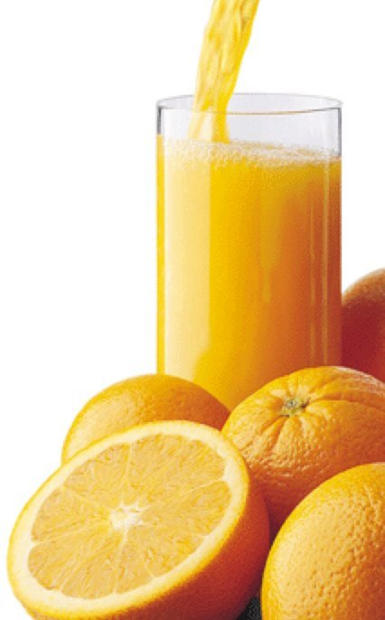
Ion chromatogram of orange juice
K⁺
detector
response
Na⁺
Mg²⁺
Fe³⁺
Ca²⁺
0 5 10 15 20 25
time (minutes)
Notes:
http://antoine.frostburg.edu/chem/senese/101/matter/slides/sld009.htm

Slide 22
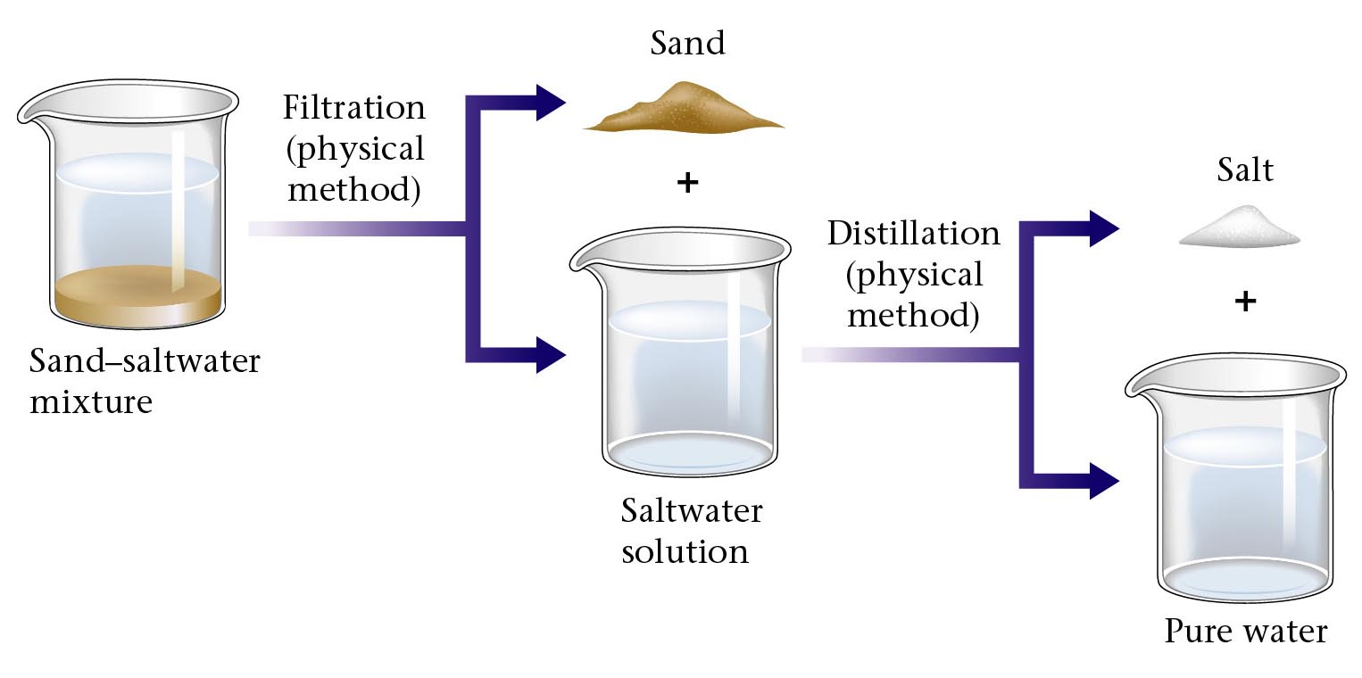
Separation of a sand-saltwater mixture.
Zumdahl, Zumdahl, DeCoste, World of Chemistry 2002, page 40

Slide 23
Separation of Sand from Salt
Gently break up your salt-crusted sand with a plastic spoon.
Follow this flowchart to make a complete separation.
Salt-
crusted
sand.
Weigh the
mixture.
Pour into
heat-resistant
container.
Add water
and stir
Stir and let
settle 1
minute.
Dry
sand.
Calculate
weight of
salt.
Weigh
sand.
Decant
clear
liquid.
How does this flow
chart insure a complete
separation?
Evaporate
to
dryness.
Wet
sand.
Repeat
3 times?
Yes

Slide 24
Reviewing concepts
1. List seven examples of physical properties.
2. Describe three uses of physical properties.
3. Name seven processes that are used to separate mixtures.
4. Explain what it means by term ‘volatile liquid’.

